Slide 1
Cognitive Education Brief Therapy
Masterpiece Counseling

Slide 2
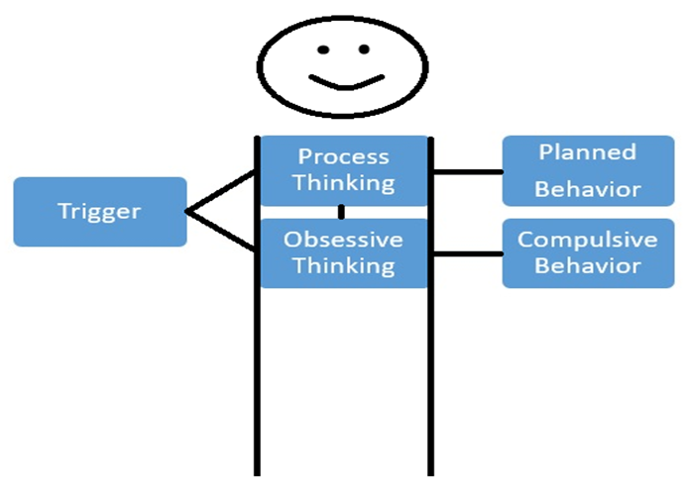
Decision Making Machine
Triggers are products of our environment and inform us of the world around us. We analyze this data to generate favorable behaviors. We sometimes develop systematic errors in the way we interpret data. Understanding this machine can help focus attention to the areas that need repair or change. We practice with identifying triggers and assign values to these, so that we become more mindful of our environment and how we interact with it. Over time we develop an understanding of our obsessions and can limit the impulsive actions and increase good strategy.

Slide 3
Measuring Behavior
0 . . . . 5 . . . . 10
The measure of behavior is its effect on survival. High quality behaviors are those that secure, enhance or directly result in survival. Low quality behaviors place an organism at risk, reduce security or cause harm. Scoring behaviors on a scale (see below) can help bring awareness to patterns and old behaviors that no longer or never did serve well. Targeting high quality behaviors with consistency is the foundation of mental health.

Slide 4
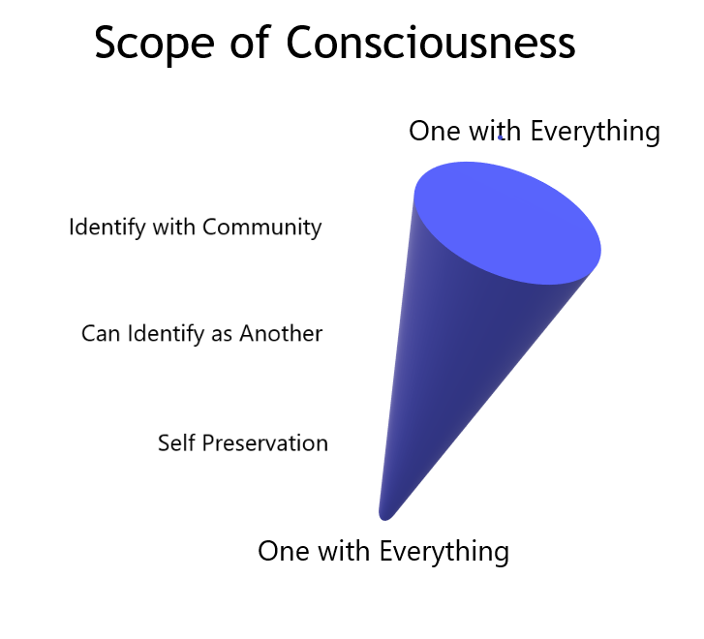

Slide 5
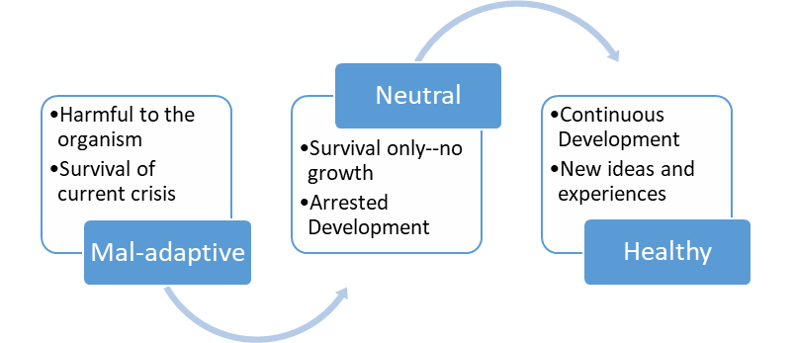
Decision Making Skills
Skill Levels:
Mal-adaptive Skills: Will always cause more harm than good.
Neutral Skills: Will cause neither harm nor growth.
Healthy Skills: Will always promote healthy development.

Slide 6
Destination/Purpose
Healthy skills and constantly making high quality decisions will generate a state of perpetual awe. By constantly using healthy skills, we begin to demand truth over comfort while becoming eager to learn more. Radical acceptance gives us a focused zeal for discovery. Increasingly, new concepts and skills become part of our survival. A lack of expectation brings clarity of vision, which helps us better harmonize with the world around us. Relieved of unnecessary stress and expectation, we reveal our individual role as only we can see it.

Slide 7
The Hero’s Journey

Slide 8
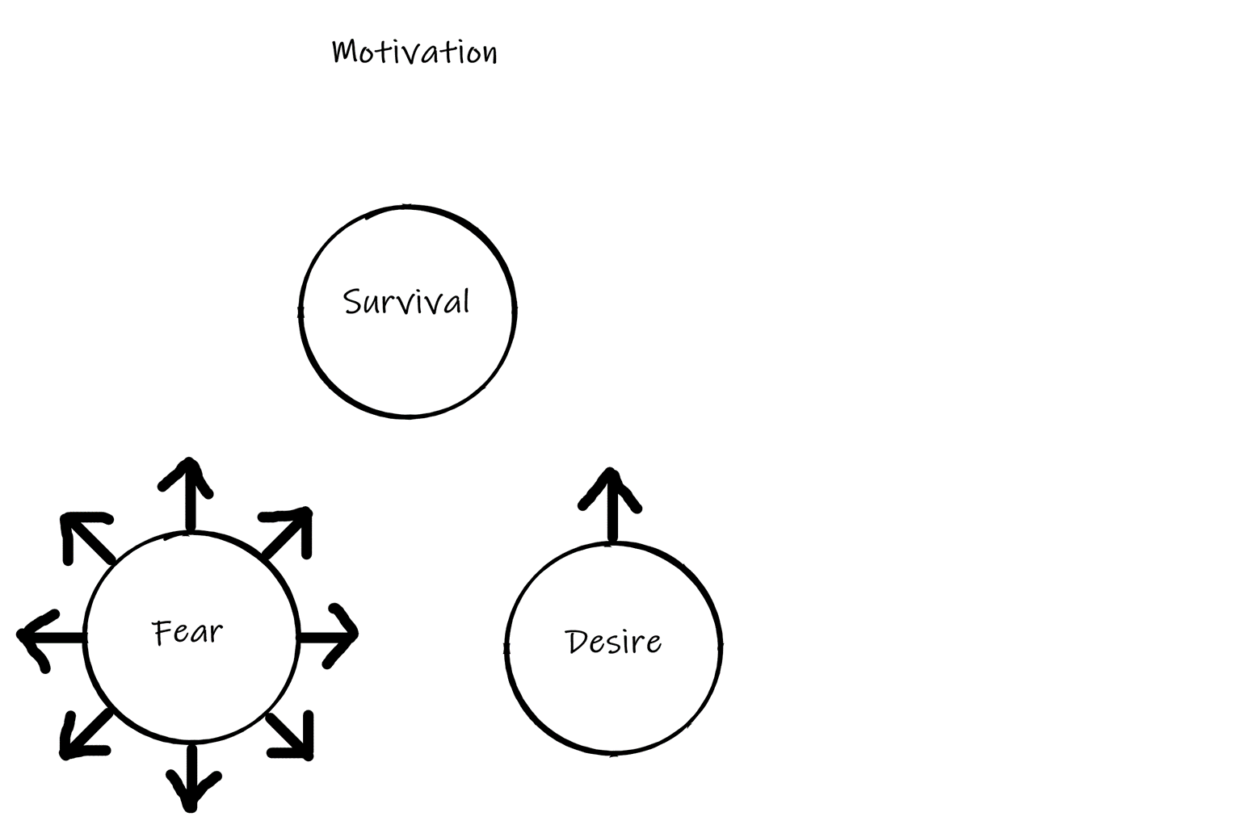
Power Pyramid

Slide 9
Awaking Authentic Self

